Slide 1
Label Noise in Classification
Jason King - jking@xsolis.com

Slide 2
Introduction
Physicist-turned-data-scientist
Single molecule trapping
Particle metrology
Simulations
Senior data scientist at XSOLIS
Case management solutions
Level of care
Length of stay
Automated coding
We are hiring!

Slide 3
Label Noise

Slide 4
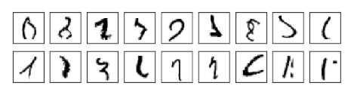
MNIST
Nielsen, Michael. Neural Networks and Deep Learning.
Notes:
The orange indicates that a radiologist did not think there was enough information to diagnose from the image alone. The red are ones where he actively disagreed.

Slide 5
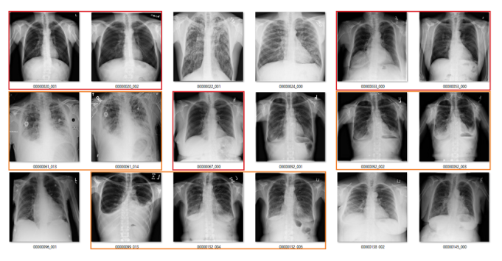
ChestXRay14
Fibrosis
Oakden-Rayner, L. Exploring the ChestXray14 dataset: problems.
Notes:
The orange indicates that a radiologist did not think there was enough information to diagnose from the image alone. The red are ones where he actively disagreed.

Slide 6
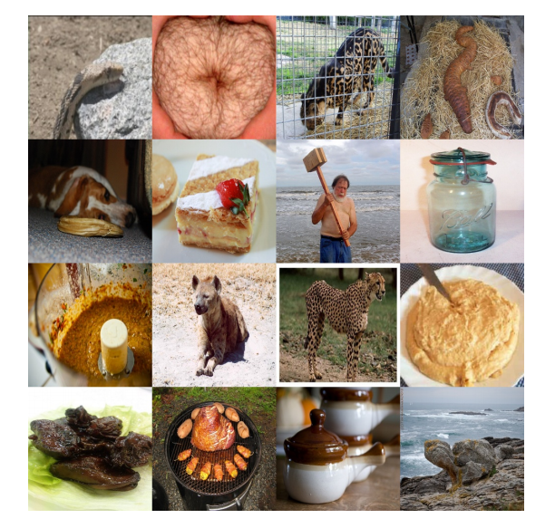
ImageNet
Ekambaram, R., Goldgof, D.B., and Hall, L.O. "Finding label noise examples in large scale datasets,"
Notes:
Top down, left to right: alligator, bagel, cheetah, crocodile, donut, french bread, hammer, hatchet, italian bread, jackal, jaguar, ladle, oyster, plate, soup bowl, tortoise.

Slide 7
Objectives
Understand the various types of label noise
Investigate their effects
Fabricate simple datasets
Simulate label noise
Methods to mitigate the effects of label noise

Slide 8
Types of Label Noise
NCAR: Noisy Completely At Random
The probability of error is entirely random
NAR: Noisy At Random
The probability of error depends on the true class, Y
NNAR: Noisy Not At Random
The probability of error is dependent on the true class, Y, and the features, X

Slide 9
Datasets

Slide 10
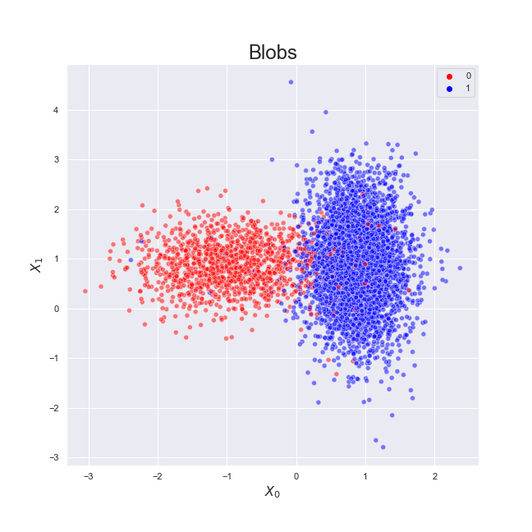
0: 1267
1: 3733

Slide 11
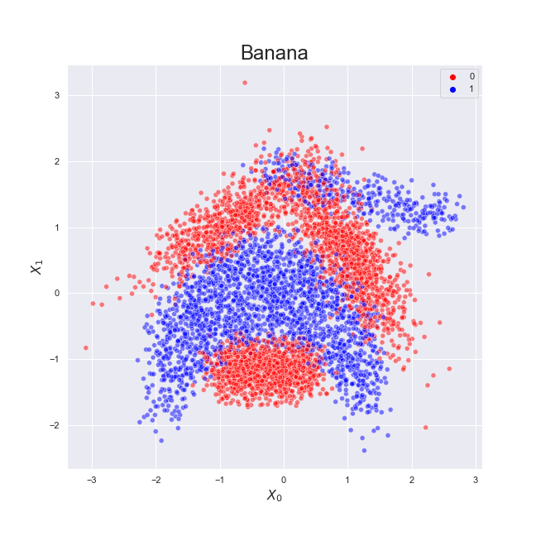
0: 2924
1: 2376

Slide 12
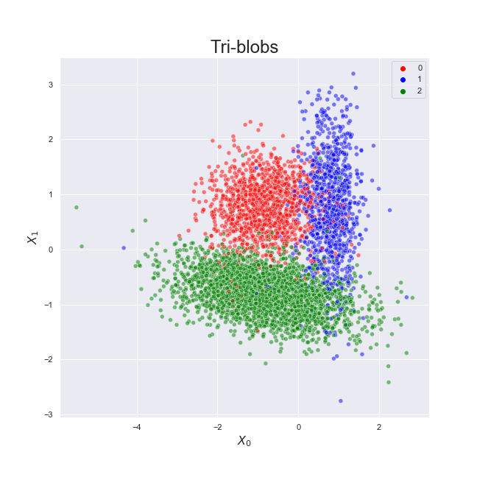
0: 1260
1: 999
2: 2741

Slide 13
Baseline performance
Dataset
Simple models
Blobs: Logistic Regression
Banana: K-Nearest Neighbors (k=10)
Tri-blobs: Random Forest (n=20)
Evaluation metric
Methodology
200 samples per dataset
Split into train/test
Train model
Generate predictions
Compute metrics
Gather results

Slide 14
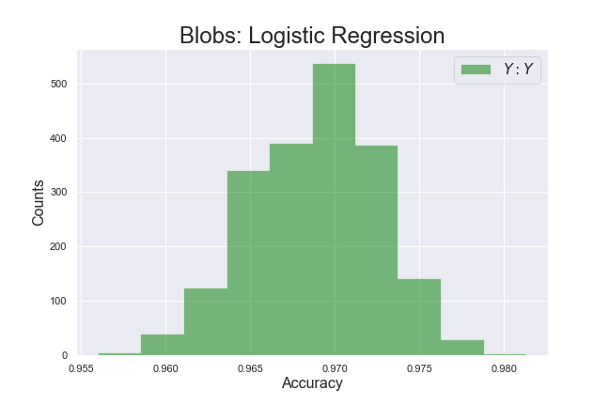

Slide 15
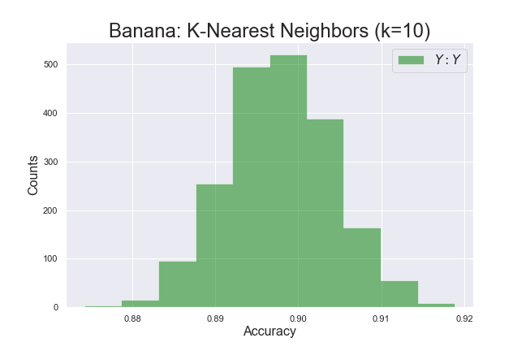

Slide 16
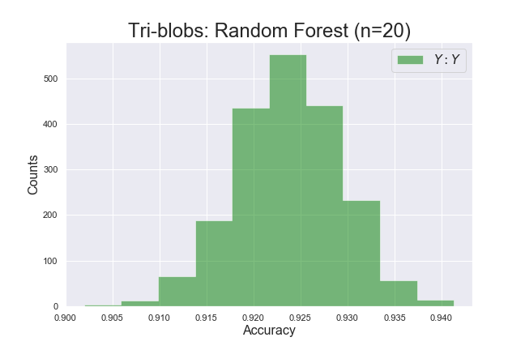

Slide 17
Performance with Noise
Dataset
Dataset
Simulate noise
Split into train/test
Split into train/test
Add Noise!
Train model
Train model
Generate predictions
Generate predictions
Compute metrics
Compute metrics
Gather results
Gather results

Slide 18
Simulate Noise
Requirements
Type of noise
Amount
Generalized framework
Permute dataset
For each point in dataset:
Generate sampling weights
Sample new label
Check noise level
Repeat steps 1 and 2 until desired amount of noise is reached

Slide 19
Simulated NCAR
Dataset
Simulate noise
Noise Completely at Random
Not dependent on features or true label
Uniform sampling weights
Split into train/test
Train model
Generate predictions
classes = [0,1,2]
weights = [1,1,1]
y_new = numpy.random.choice(classes, p=weights)
Compute metrics
Gather results

Slide 20
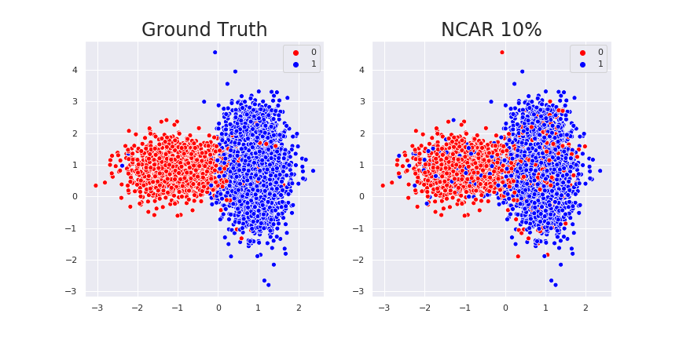
Blobs: NCAR

Slide 21
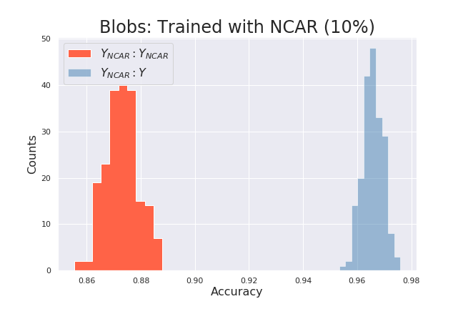
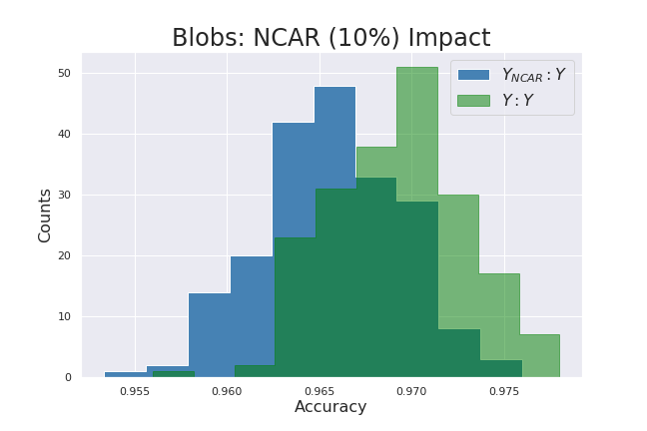
Blobs: NCAR

Slide 22
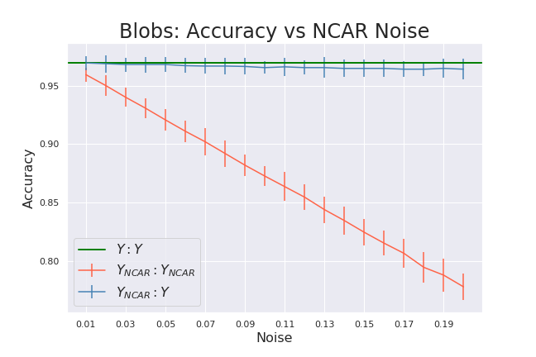

Slide 23

Blobs: NCAR (Tuned)

Slide 24
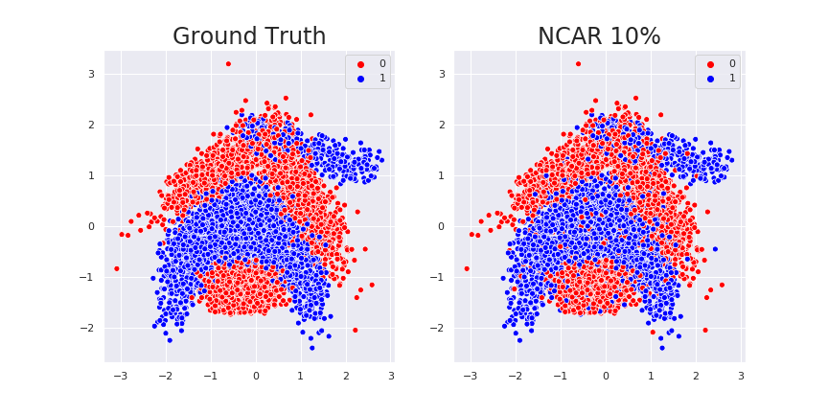
Banana: NCAR

Slide 25
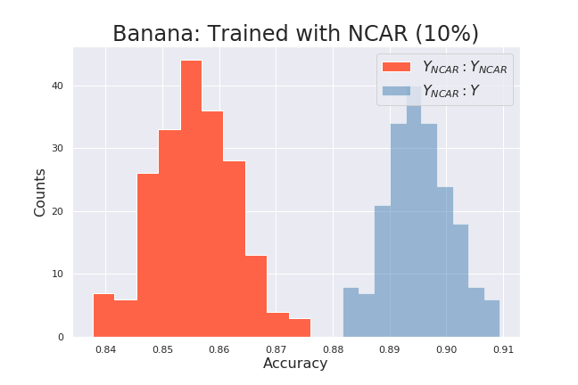
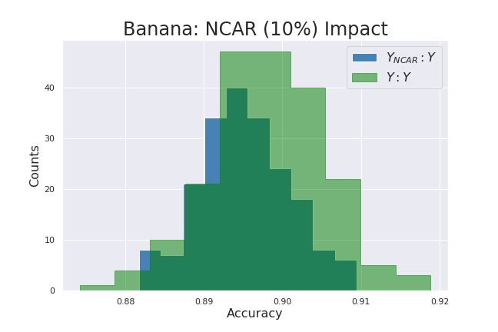
Banana: NCAR

Slide 26
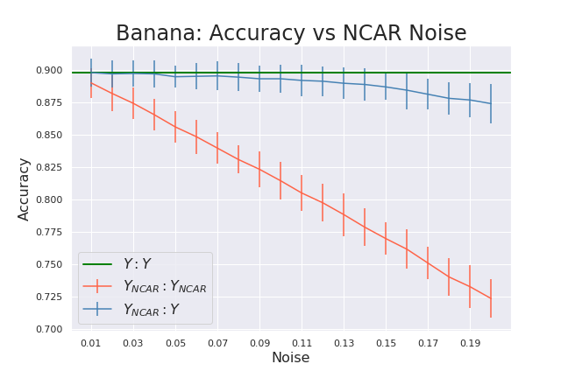

Slide 27
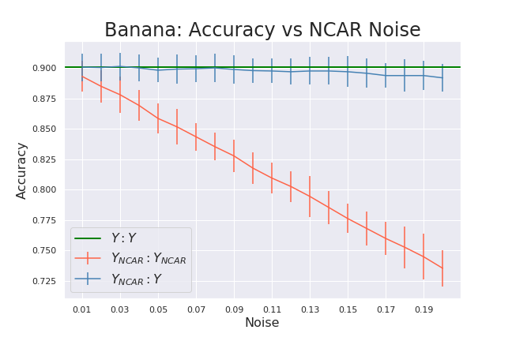
Banana: NCAR (Tuned)

Slide 28
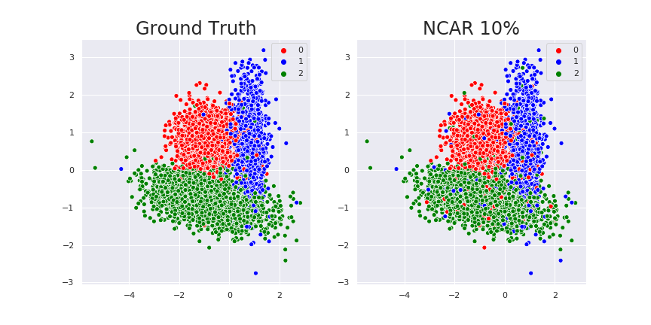
Tri-blobs: NCAR

Slide 29
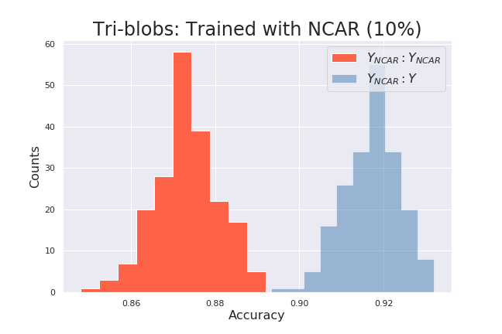
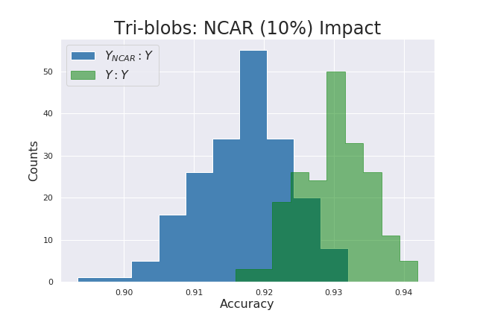
Tri-blobs: NCAR

Slide 30
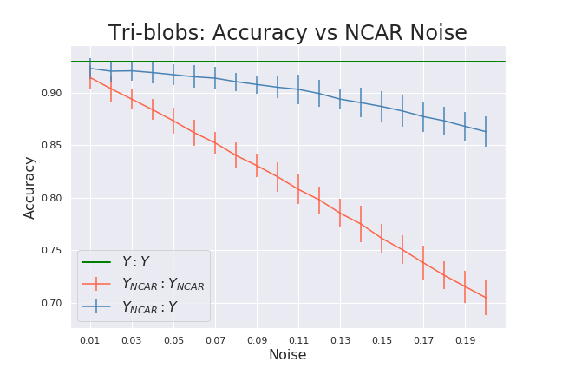

Slide 31
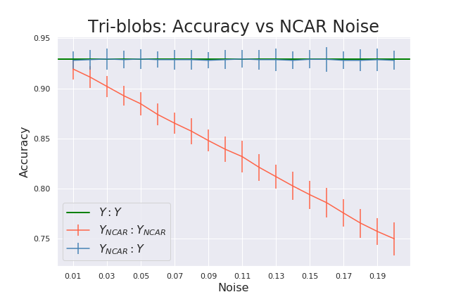
Tri-blobs: NCAR (Tuned)

Slide 32
Simulated NAR
Dataset
Simulate noise
Noise at Random
Dependent on true label
Sampling weights scaled by class size
Split into train/test
Train model
Generate predictions
classes = [0,1,2]
weights = [1260, 999, 2741]
y_new = numpy.random.choice(classes, p=weights)
Compute metrics
Gather results

Slide 33
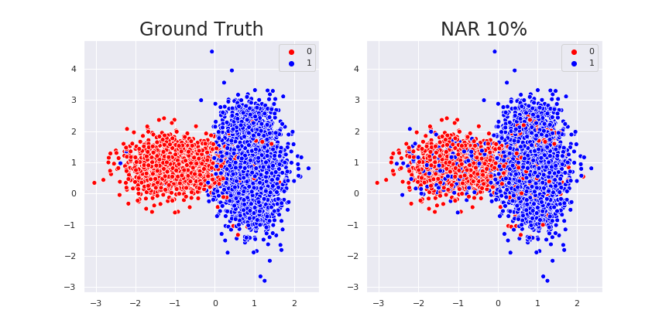
Blobs: NAR

Slide 34
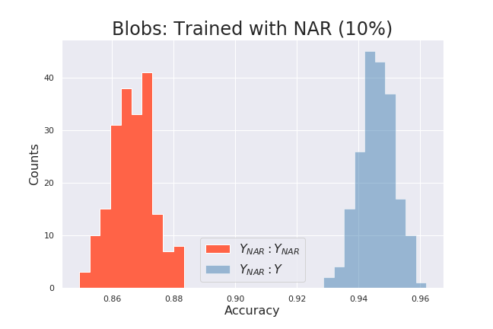
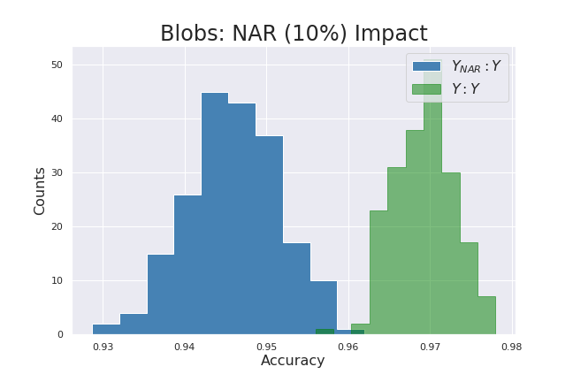
Blobs: NAR

Slide 35
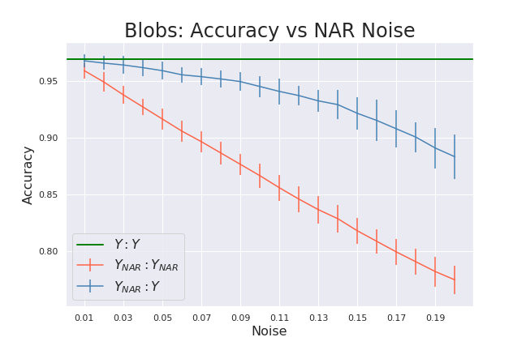

Slide 36
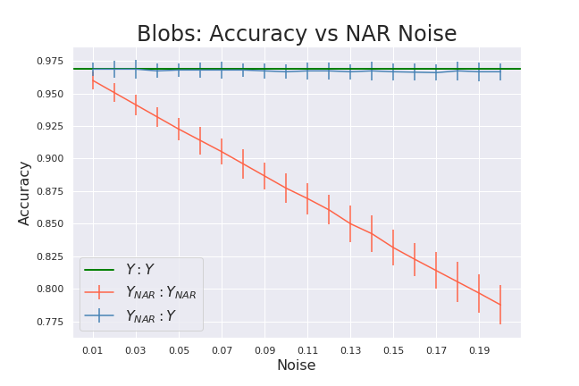
Blobs: NAR (Tuned)

Slide 37

Banana: NAR

Slide 38
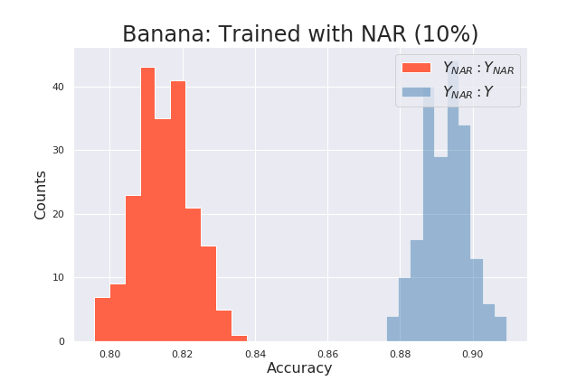
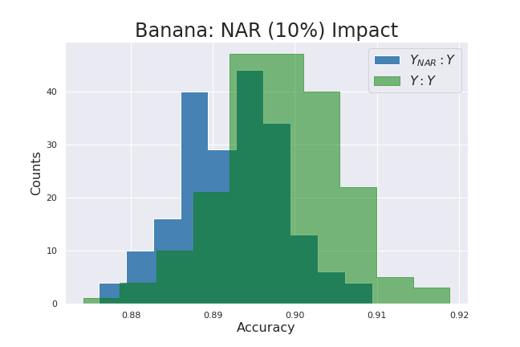
Banana: NAR

Slide 39
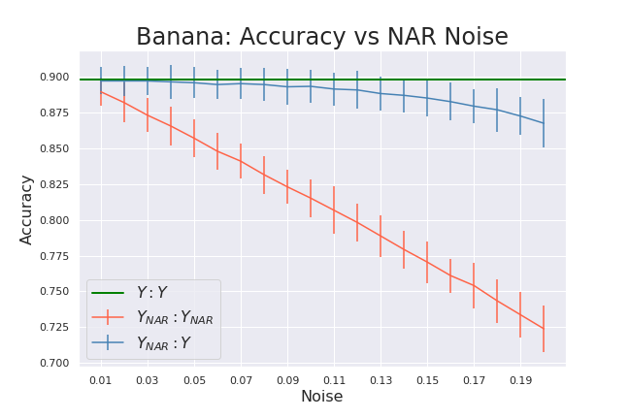

Slide 40
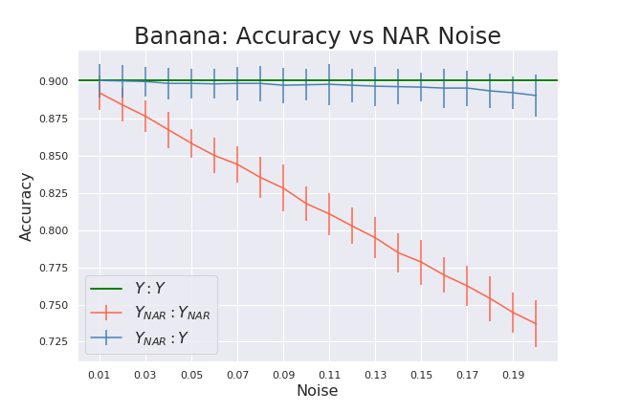
Banana: NAR (Tuned)

Slide 41
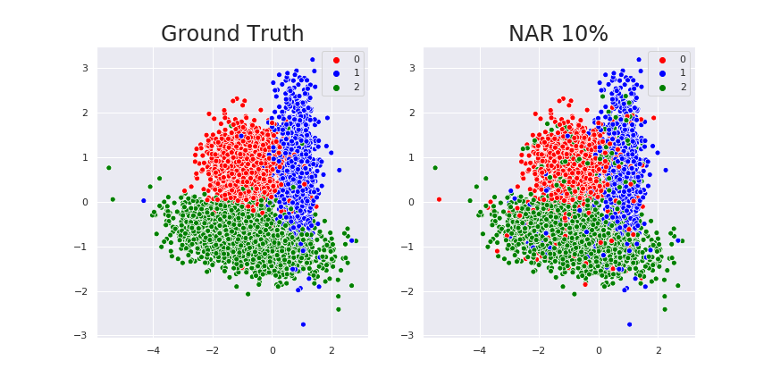
Tri-blobs: NAR

Slide 42
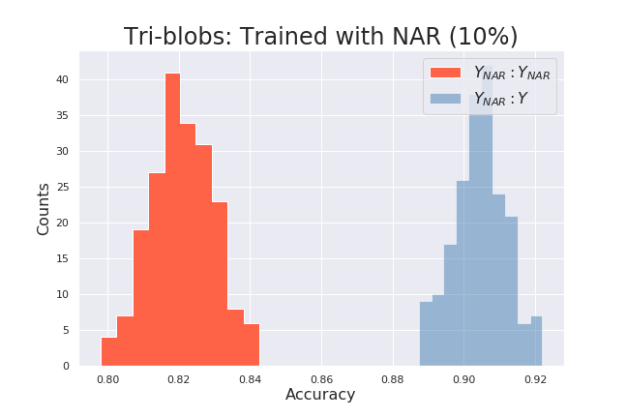
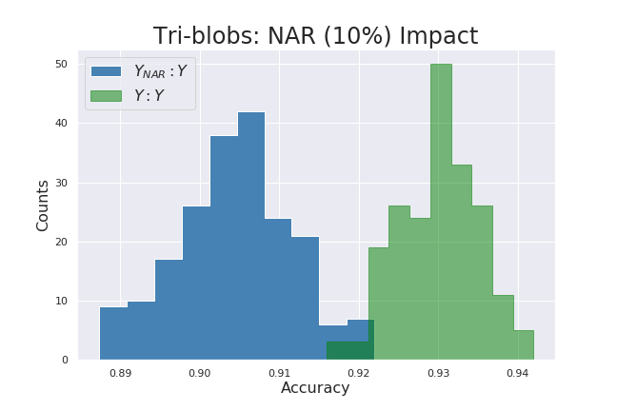
Tri-blobs: NAR

Slide 43


Slide 44


Tri-blobs: NAR (Tuned)

Slide 45
Simulated NNAR
Dataset
Simulate noise
Noise Not at Random
Dependent on true label and features
Sampling weights scaled by:
Class size
Class representation near instance (i)
Split into train/test
Train model
Generate predictions
Compute metrics
classes = [0,1,2]
weights = [1260, 999, 2741]
weights *= knn.predict_proba(X[i])
y_new = numpy.random.choice(classes, p=weights)
Gather results

Slide 46
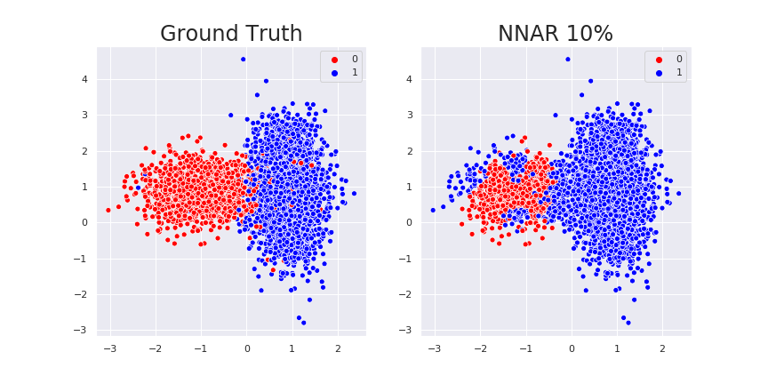
Blobs: NNAR

Slide 47
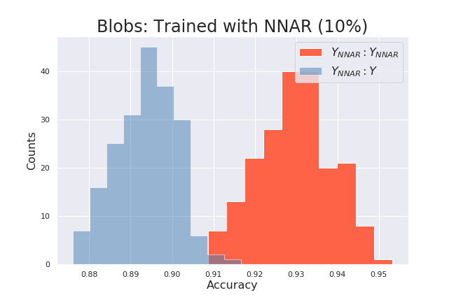
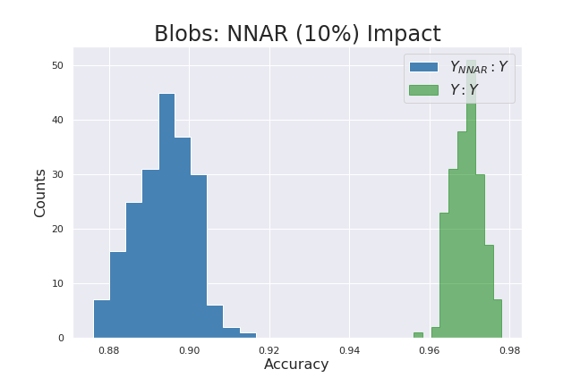
Blobs: NNAR

Slide 48
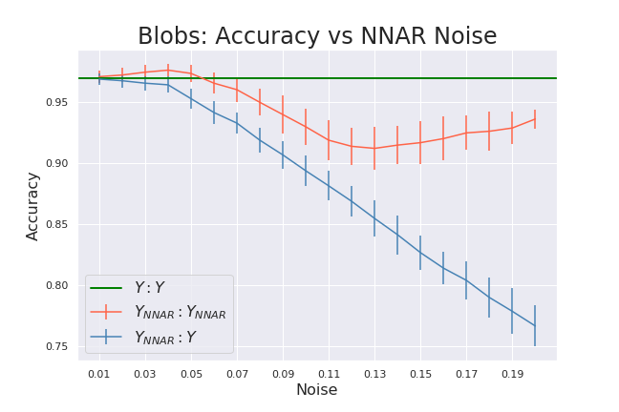

Slide 49
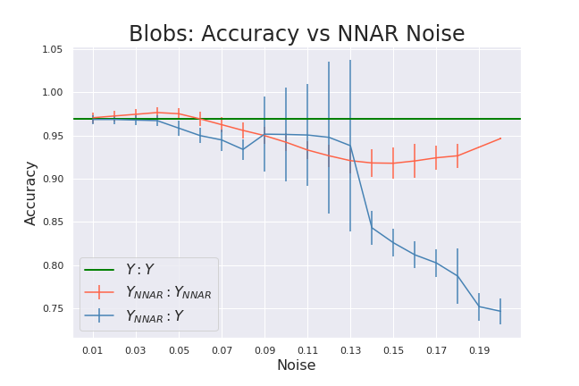
Blobs: NNAR (Tuned)

Slide 50
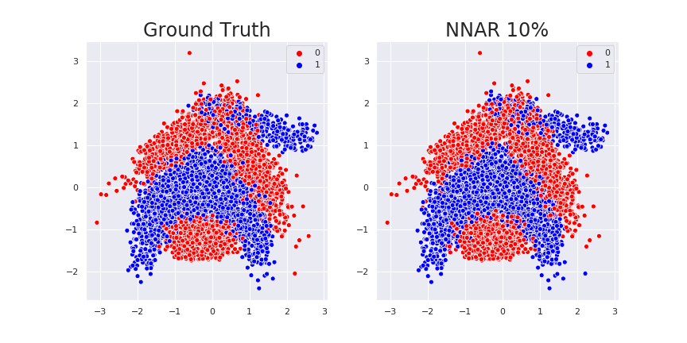
Banana: NNAR

Slide 51
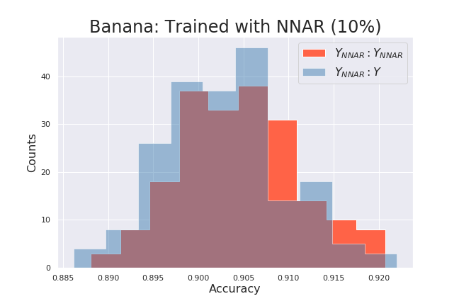
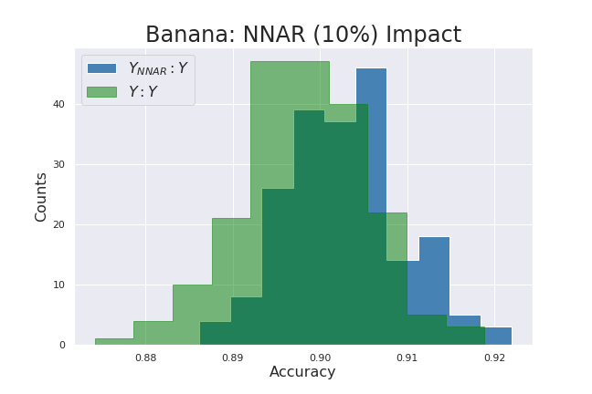
Banana: NNAR

Slide 52
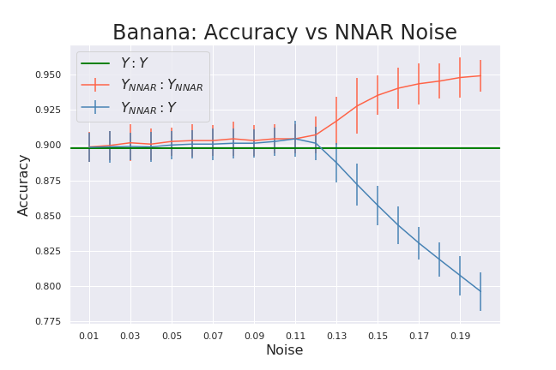

Slide 53
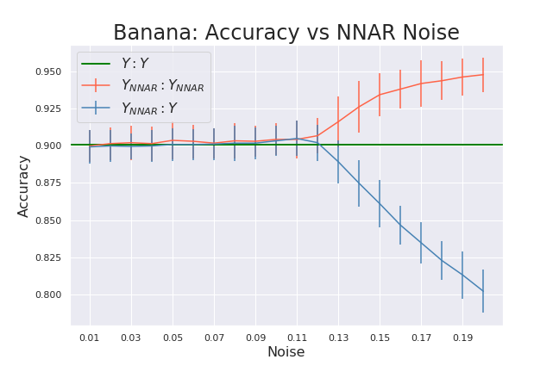
Banana: NNAR (Tuned)

Slide 54
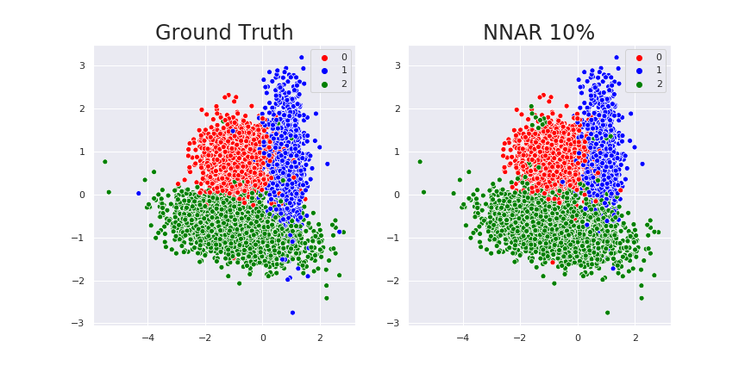
Tri-blobs: NNAR

Slide 55
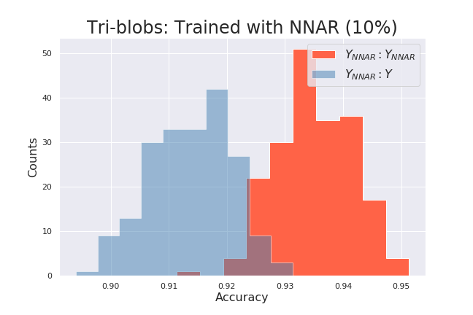
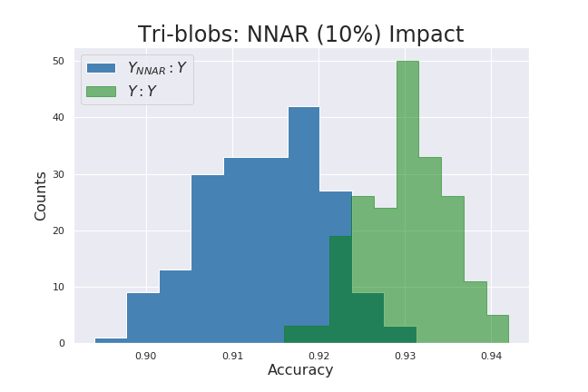
Tri-blobs: NNAR

Slide 56
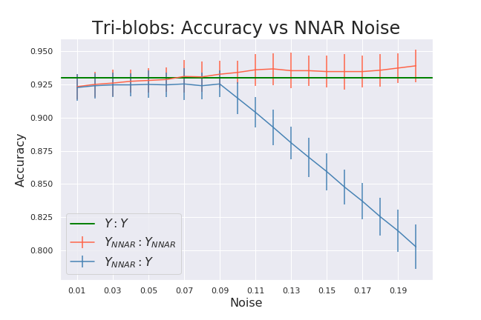

Slide 57
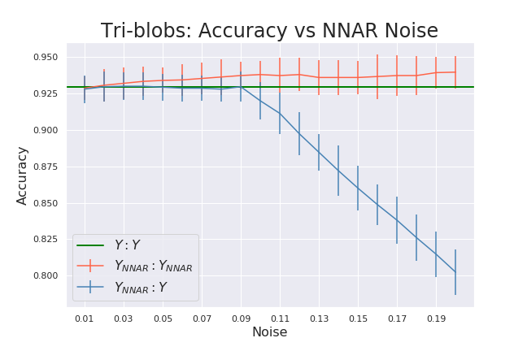
Tri-blobs: NNAR (Tuned)

Slide 58
Recap
Types of Label Noise
NCAR: Noisy Completely At Random
NAR: Noisy At Random
NNAR: Noisy Not At Random
Simulated Noise
Effects on model performance
NCAR and NAR: lower apparent performance and slightly reduced true performance
NNAR: higher apparent performance and decreased true performance
Hyperparameter tuning can help…in some cases

Slide 59
Questions?
jking@xsolis.com

Slide 60
References
Frénay, B., Verleysen, M. Classification in the Presence of Label Noise: a Survey. IEEE Trans. Neural Networks and Learning Systems, 25(5), 2014, p. 845-869.
Frénay, B., Kabán A. A Comprehensive Introduction to Label Noise. In Proc. ESANN, Bruges, Belgium, 23-25 April 2014, p. 667–676.
Bootkrajang, J. and Ata K. Boosting in the presence of label noise. CoRR abs/1309.6818 (2013): n. pag.
Nematzadeh Z., Ibrahim R., Selamat A. Class Noise Detection Using Classification Filtering Algorithms. CIIS 2016. Advances in Intelligent Systems and Computing, vol 532.
Ekambaram, R., Goldgof, D.B., and Hall, L.O. "Finding label noise examples in large scale datasets," 2017 IEEE International Conference on Systems, Man, and Cybernetics (SMC), Banff, AB, 2017, pp. 2420-2424.
Oakden-Rayner, L. Exploring the ChestXray14 dataset: problems. Luke Oakden-Rayner, 18 Dec 2017, https://lukeoakdenrayner.wordpress.com/2017/12/18/the-chestxray14-dataset-problems/.
Nielsen, M. Neural Networks and Deep Learning. Determination Press, 2015.

Slide 63


